Slide 1

Intelligent automotive management system

Slide 2
TEAM
MENTOR
RESMIPRIYA M G
Asst. Professor
CSE,AJCE
Members
MIRANDA MOHAN (13002177)
NITHIN IGNATIUS (13002181)
PRIYANKA MOHAN (13002184)

Slide 3
INTRODUCTION
Intelligent Automotive Management System focuses on detection and monitoring of the bus.
It helps the system administrator to check which bus has entered the bus station .
It also consist of an automatic voice announcement which announces the bus entered into the bus station and the route of that particular bus.

Slide 4

PROBLEMS

Slide 5


Slide 6
EXISTING SYSTEM
Automatic Bus Location Announcement System using GPS
Wireless communication can be defined as transfer of information between two or more points without using wires or cables.

Slide 7
PROPOSED SYSTEM
INTELLIGENT automotive MANAGEMENT SYSTEM
Detect the bus entering and leaving the bus stand using RFID readers and tags.
Automatically announces the arrival ,departure of a bus in the bus stand.
Automatically announces the routes of a bus by interacting with the database.

Slide 8
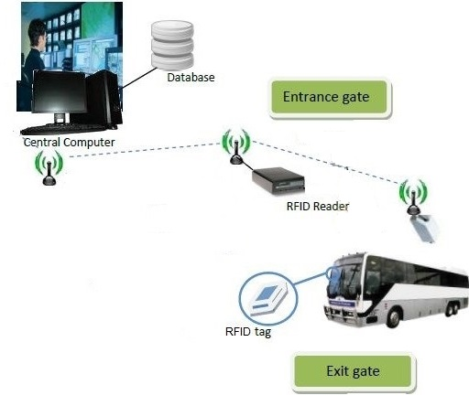
SYSTEM ARCHITECTURE

Slide 9
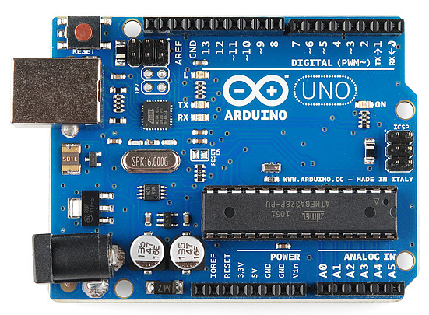
COMPONENTS
ARDUINO
Arduino is an open-source electronics platform based on easy-to-use hardware and software.
Arduino boards are able to read inputs - light on a sensor, a finger on a button, - and turn it into an output - activating a motor, turning on an LED.

Slide 10
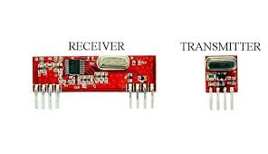
RFID MODULE
An RFID system consists of two separate components: a transmitter and a receiver.
This is a 434MHz RF transmitter and receiver which is used for short range wireless control applications.

Slide 11
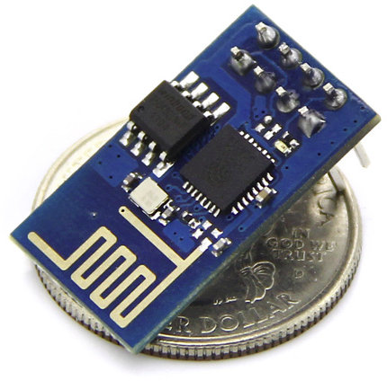
Wi-Fi MODULE
ESP8266 Wi-Fi module is Wi-Fi serial transceiver module, based on ESP8266.
It works on 3.3V and consumes current up to 250mA.

Slide 12
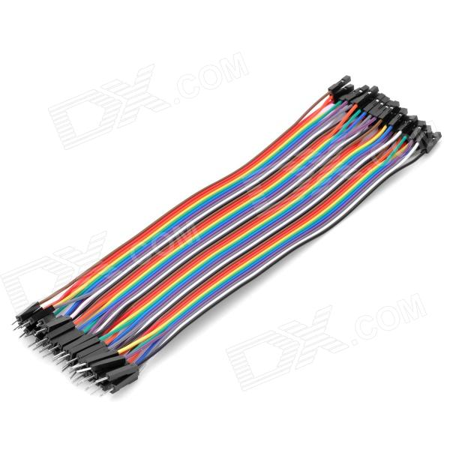
JUMPER WIRES
A jump wire is an electrical wire or group of them in a cable with a connector or pin at each end which is normally used to interconnect the components.
RF connectors – are used to carry radio frequency signals between circuits, test equipment, and antennas.

Slide 13
SPECIFICATIONS
LANGUAGES USED
Objective C
MySQL
SOFTWARE Required
Arduino IDE

Slide 14
CONCLUSION
Our design aims to solve the problem of real-time monitoring of buses in bus station.
Both passenger and bus station administrators will benefit from the system as real time information are provided.
The bus owners will definitely get the benefit, since the number of passengers will increase.
By the implementation of this system, problems such as underutilization of buses fleet and long waiting time at the bus station will be reduced.

Slide 15
FUTURE ENHANCEMENT
Tracking of bus using GPS.
Provides this facility to the registered users also.
Changes to Raspberry pi platform to ease the complexity of product.

Slide 16
REFERENCES
Ben Ammar Hatem and Hamam Habib : Bus Management System Using RFID In WSN ,presented at the European and Mediterranean Conference on Information Systems 2010.
Komal Satish Agarwal and Kranti Dive :RFID Based Intelligent Bus Management and Monitoring System ,presented in the International Journal of Engineering Research & Technology (IJERT) , Vol. 3 Issue 7, July – 2014.

Slide 17

MODULES
MODULE 1 : Detection of bus.
MODULE 2 : Sending the detected value to administrator and fetching the details according to the ID of detected bus.
MODULE 3 : Automated Voice announcement.

Slide 18
THANK YOU

